Slide 1
ScopeCSVReport Pre-Alpha Demo and Feedback
Raj Vinjamuri
01/20/2016

Slide 2


Motivation
Automation of ‘Super 40 DVT Phase I’ data analysis (72 csv files)
Up to 5M record length 4-channel data.

Slide 3
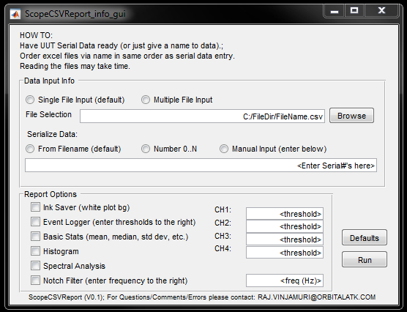
Function: Generate plots and a report for scope data

Slide 4
Features
Code is modular
Single file read, plot, histogram, frequency spectrum, etc.
User-input check and correction
File read runtime optimization (utilizes importdata())
Flexibility
1 to 4 channels of data
Resizing of figures based on number of channels
inkSaver figure color option
Works with multiple Tektronix scope models

Slide 5
Demo
Matlab

